Slide 1

Introduction to A Level Media Studies
You should have the following on completion of these tasks:
Notes on the theoretical framework in Media Studies
A 500 - 750 word analysis of newspaper front covers on Dominic Cummings
A photo story using different camera shots
Notes on the five contexts
A 800 - 1000 word essay exploring how different contexts affect media texts

Slide 2


TASK 1
WHAT ARE THE FOUR THEORETICAL FRAMEWORKS IN MEDIA STUDIES?
TURN ON YOUR SOUND

Slide 3

TASK 2
THINK ABOUT THE MAIN PROTAGONIST IN THIS VIDEO. WHAT ARE THE DIFFERENT WAYS HE IS REPRESENTED?
WRITE A SUMMARY
EXPLAINING THE DIFFERENT WAYS HE IS REPRESENTED.
TURN ON YOUR SOUND

Slide 4
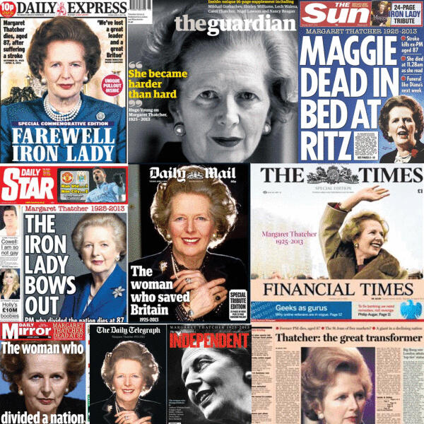
TASK 3
MAKE NOTES ON EACH NEWSPAPER FRONT PAGE.
WHAT IMPRESSION DO YOU GET OF THEIR REPRESENTATION OF THATCHER?
HOW DO YOU KNOW? WHAT DO YOU THINK THEIR POLITCAL VIEWS OF HER WERE?
THESE ARE THE FRONT PAGES OF BRITISH NEWSPAPERS ON THE DAY THAT FORMER PRIME MINSTER MARGARET THATCHER DIED.

Slide 5

ANNOTATE AND ANALYSE THE FOLLOWING NEWSPAPER FRONT COVERS.
HOW IS DOMINIC CUMMINGS REPRESENTED?
TASK 4

Slide 6

TASK 5
CLICK ON THE BOX AND MAKE NOTES ON THE DIFFERENT TYPES OF CAMERA SHOTS.

Slide 7
TASK 6
PLAN AND SHOOT A SEQUENCE WHICH HIGHLIGHTS DIFFERENT CAMERA SHOTS SIMILAR TO THIS IMAGE.
THE SCENARIO FOR YOUR SEQUENCE IS YOU ARE WAITING FOR A DELIVERY.

Slide 8
TASK 7
WHAT ARE THE FIVE CONTEXTS THAT INFLUENCE TEXTS IN MEDIA STUDIES?
TURN ON YOUR SOUND

Slide 9

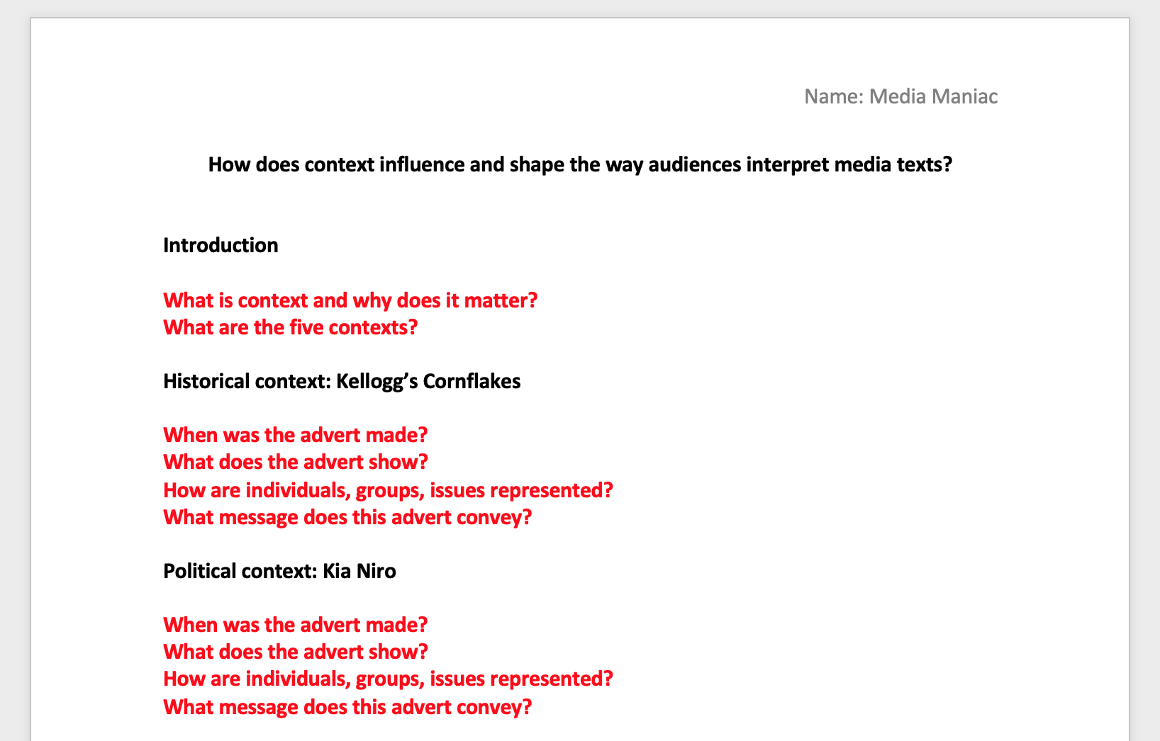

TASK: WRITE AN ESSAY EXPLORING HOW THE FIVE DIFFERENT CONTEXTS INFLUENCE MEDIA TEXTS
ESSAY TITLE: How does context influence and shape the way audiences interpret media texts?
You need to write an essay between
800 – 1000 words. This needs to be submitted as a Word .doc.
You need to research background information on each advert to help you answer the questions about the text.
I want to see you demonstrating critical thinking and independent learning.

Slide 10
KELLOGG’S CORNFLAKES
Watch the advert again, make notes and consider the:
HISTORICAL CONTEXT
How is this advert influenced
by the time it is made?

Slide 11
KIA NIRO
Watch the advert again, make notes and consider the:
POLITICAL CONTEXT
How is this advert influenced
by any political issues?

Slide 12
DESPICABLE ME
Watch the advert again, make notes and consider the:
ECONOMIC CONTEXT
How is this advert influenced
by the ownership of this media?

Slide 13
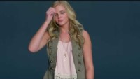
ALWAYS
Watch the advert again, make notes and consider the:
SOCIAL CONTEXT
How is this advert influenced
by changes within our social structures?

Slide 14
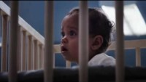
NIKE
Watch the advert again, make notes and consider the:
CULTURAL CONTEXT
How is this advert influenced
by cultural beliefs and attitudes?

